Slide 1

Github

Slide 3



Slide 4
$git - -version
$git config - -list
$git config - -global user.name “user_name”
$git config - -global user.email “gitemail568@gmail.com”

Slide 5


My-project
Working directory

Slide 6
$git init
Initialized empty Git repository in /Users/kammili.damodar/Downloads/IP/program_track/.git/

Slide 7
$git init
Initialized empty Git repository in /Users/kammili.damodar/Downloads/IP/program_track/.git/
.git

Slide 8
Myproject
.git
Working directory
Calculator.c
Task_manager.c

Slide 9
Myproject
.git
Working directory
Calculator.c
Task_manager.c

Slide 10

Git status
$git add <filename>
Calculator.c
Task_manager.c

Slide 11
Myproject
.git
.git
Working directory
Calculator.c
Calculator.c
Task_manager.c
Task_manager.c

Slide 12

$git commit2

Slide 13
.git
.commit2
.commit1

Slide 14
$git log
After you have created several commits, or if you have cloned a repository with an existing commit history, you’ll probably want to look back to see what has happened. The most basic and powerful tool to do this is the git log command.

Slide 15
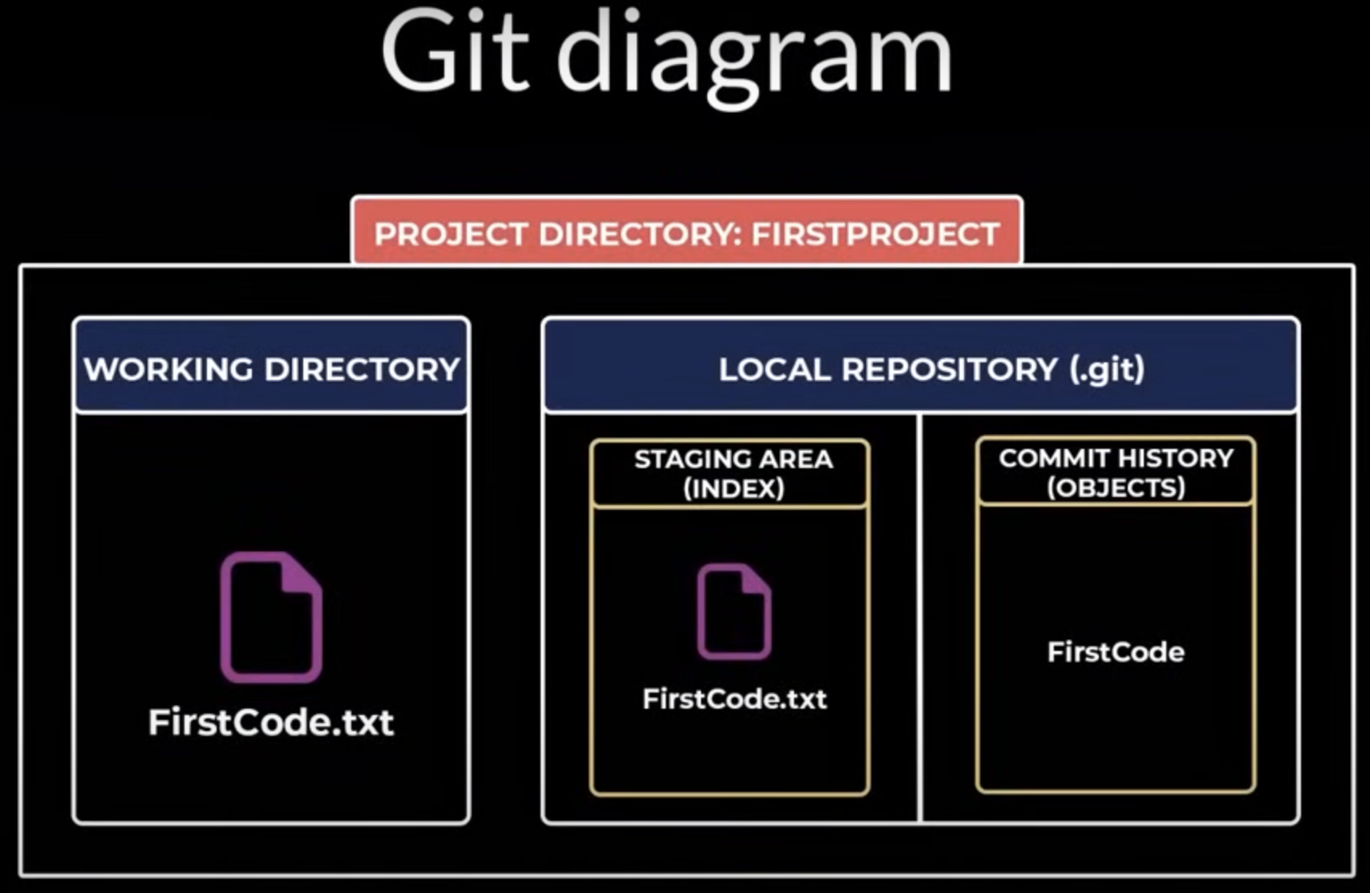

Slide 16
Life cycle of the status of your files

Slide 17
Workflow

Slide 18
help commands
$git <command name> - -help
$git help everyday
$git help tutorial
$git help tutorial -2

